Slide 1
Liver elastography – more than staging the liver disease
George Gherlan
“Carol Davila” University of Medicine and Pharmacy, Bucharest
“Dr. Victor Babes” Center for Diagnostics and Treatment, Bucharest
“Dr. Victor Babes” Hospital of Infectious Diseases, Bucharest

Slide 2

What is elastography?
The elasticity is the physical propriety of materials to regain the initial form after they have been subjected to a deforming force.
The basic ideea of elastography is that any pathological process that affects a tissue modifies its elasticity.
The palpation was the first elastography technique.

Slide 3
Elastography
First described in 2003 (Fibroscan)
Aside with contrast enhanced ulrtasonography (CEUS) represents the newest acquisitions in the ultrasound field.
At this moment many techniques are available for the measurement of the tissue elasticity. These can be divided into quantitative (quantification) and qualitative (relative).

Slide 4
Elastography
There are two types of elastographical methods:
Strain and displacement elastography - mainly qualitative (HI-RTE, VTTI).
Shear Wave elastography – measuring the velocity of a wave through the tissue. This can be:
Quantitative (TE (Fibroscan®) or VTTQ (ARFI cuantification)
Mixt (Supersonic SWE / Siemens VTTM IQ)

Slide 5
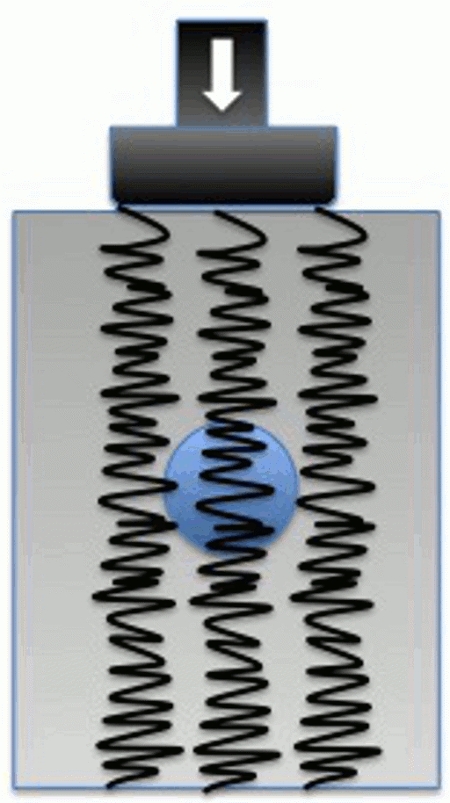
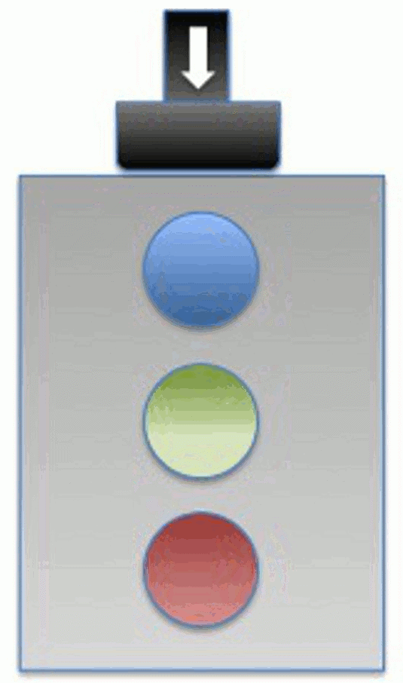
Strain and displacement elastography
Notes:
5
Se aplica un stimul de o intensitate cunoscuta si se compara imaginea initiala cu diferite momente. Pe baza unor algoritmi se determina elasticitatea fiecarui tip de tesut din imagine (sau elasticitatea relativa). Se pot folosi vibratii manuale ale tranductorului, pulsuri de ultrasunete sau vibratiile fiziologice (respiratie/activitate cardiaca).

Slide 6
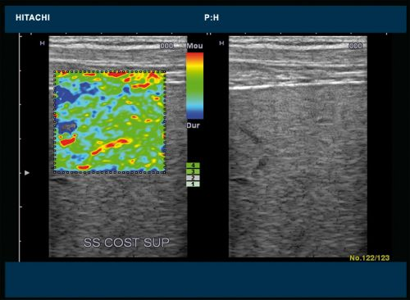
Compresional elastography RTE

Slide 7
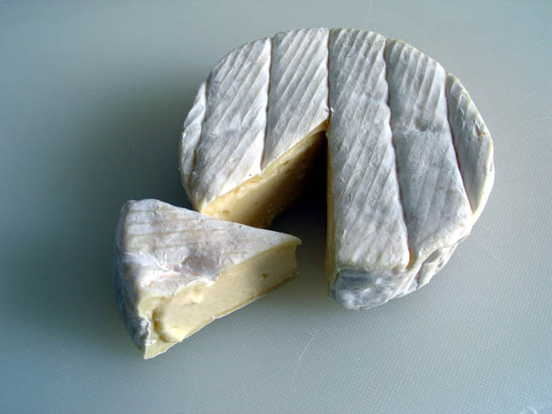
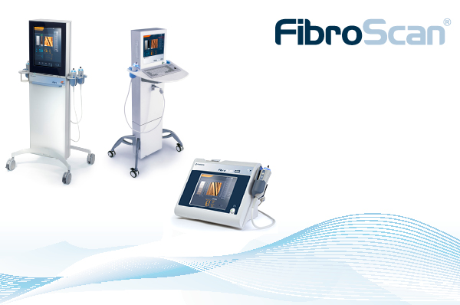
Transient elastography - Fibroscan
First quantitative method – introduced in 2003
The technique has been inspired from a device used to measure the Camembert cheese elasticity

Slide 8
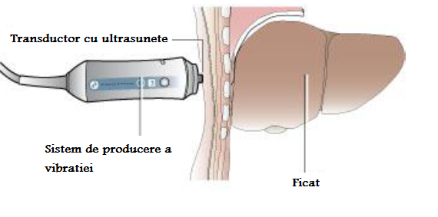
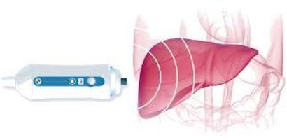
Transient elastography – the technique
Ultrasunete
Unda mecanica
Viteza deplasare

Slide 9
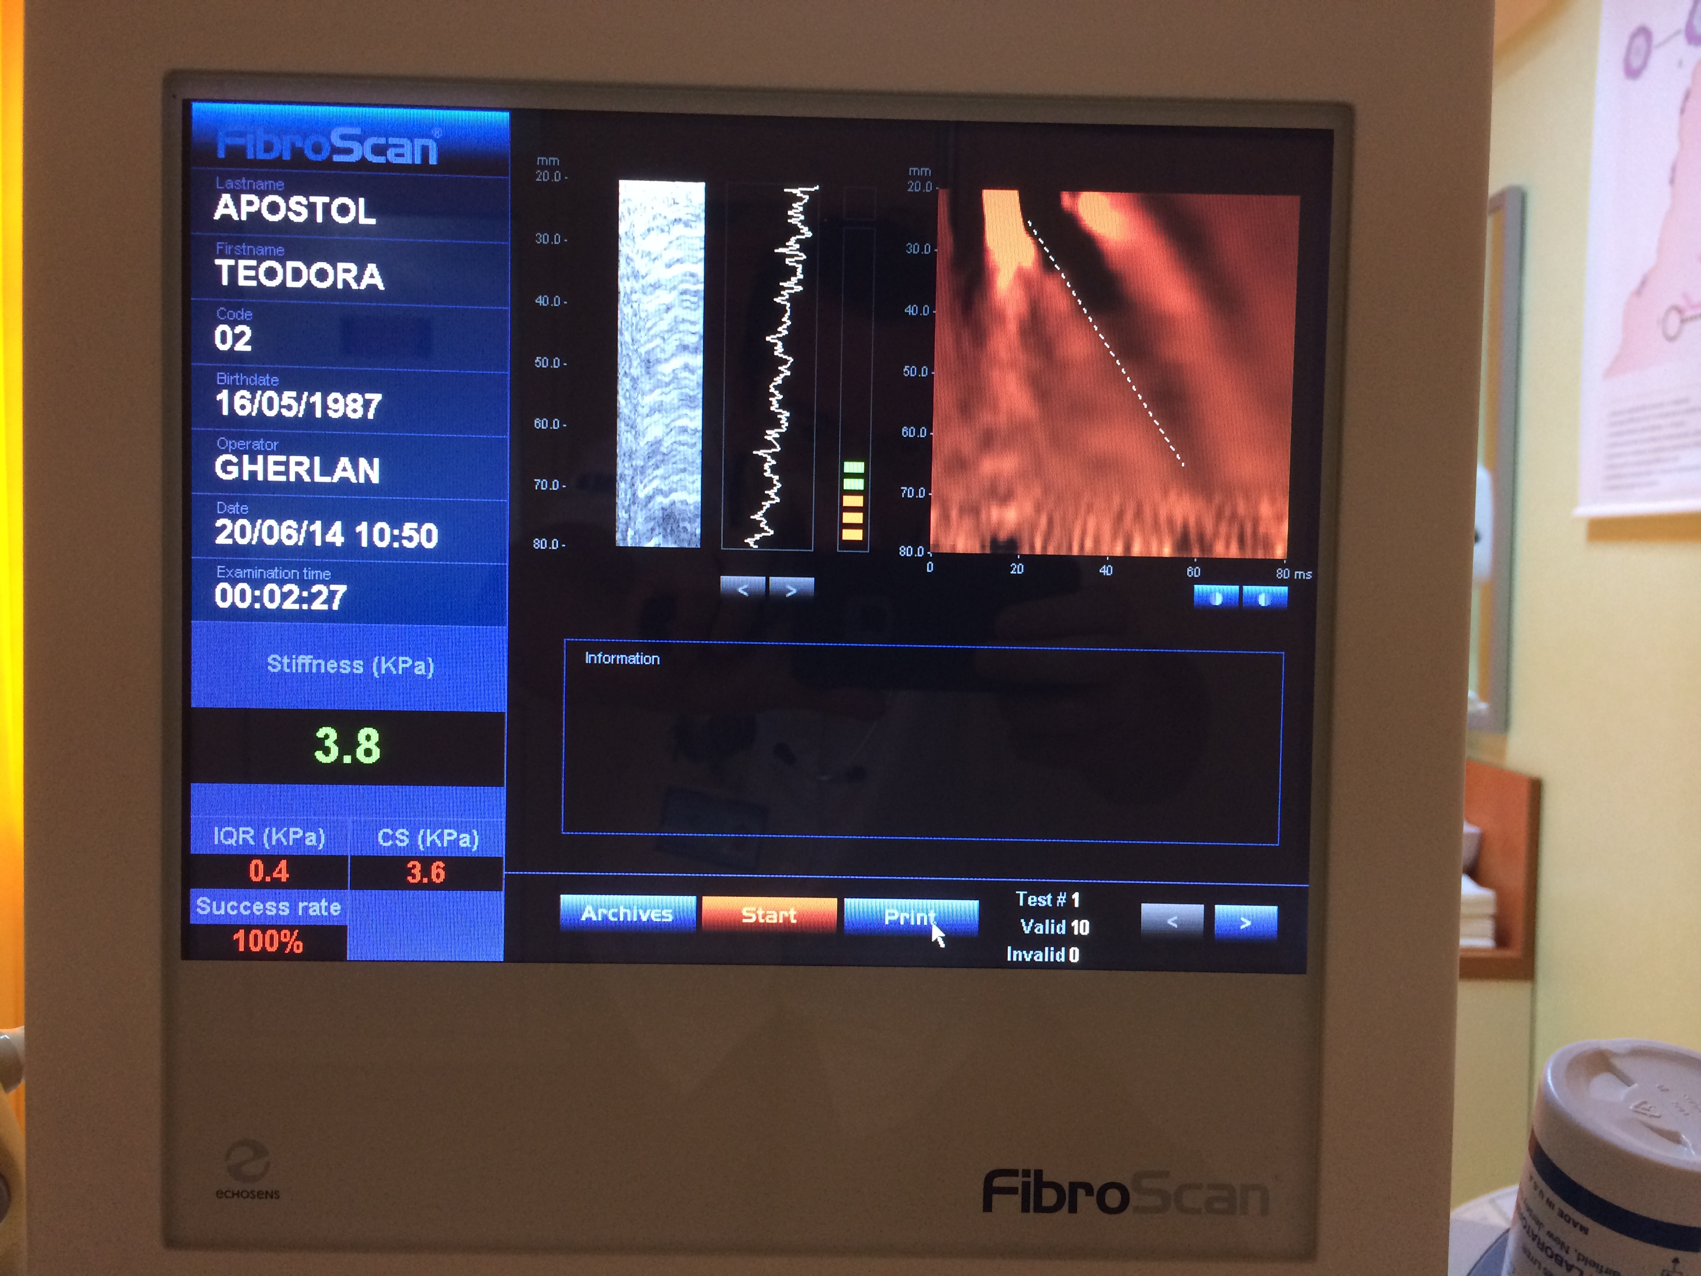
Transient elastography - Fibroscan
10 Masuratori valide
Succes > 60%
IQR < 1/3 Rezultat

Slide 10
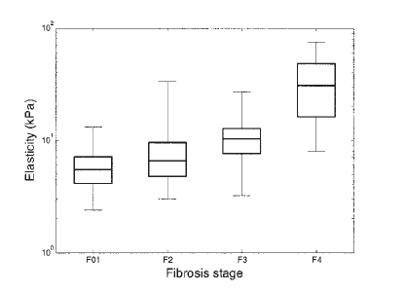
Transient elastography – Fibroscan in Hepatitis C
N=327 VHC
AUROC 0.79 F≥2, 0.97 F4
Cut-off: 8.8 KPa F2, 14.6 KPa F4
Ziol M, Handra-Luca A, Kettaneh A, Christidis C, Mal F, Kazemi F, de Lédinghen V, Marcellin P, Dhumeaux D, Trinchet JC, Beaugrand M. Noninvasive assessment of liver fibrosis by measurement of stiffness in patients with chronic hepatitis C. Hepatology. 2005 Jan;41(1):48-54. PubMed PMID: 15690481.

Slide 11
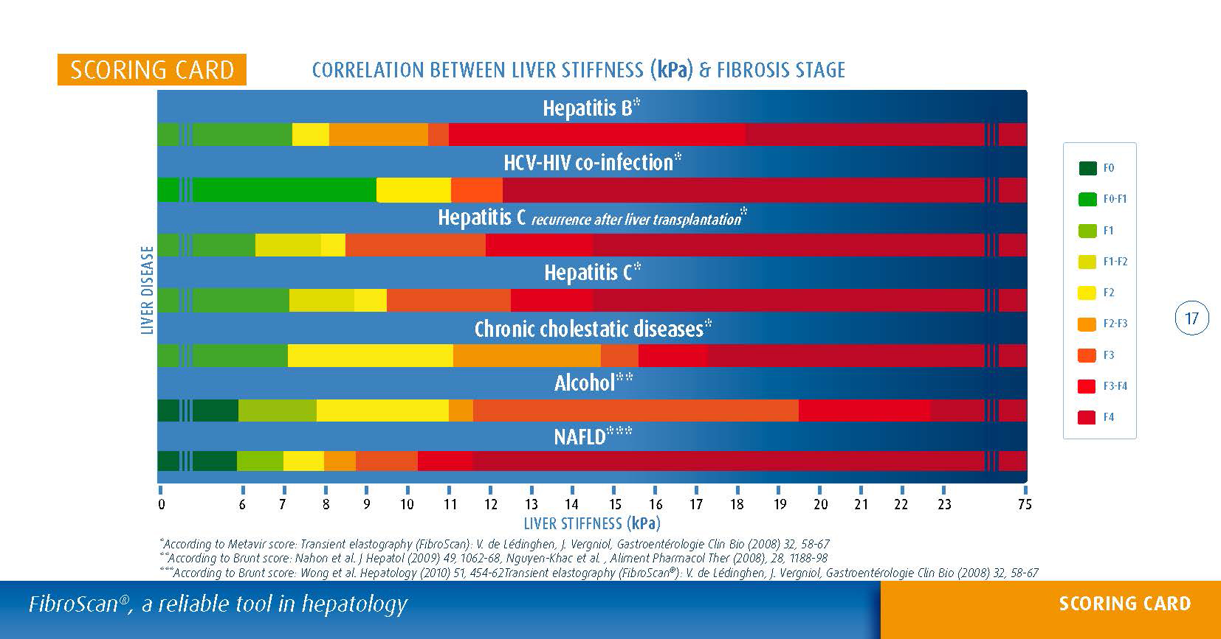
Transient elastography - Fibroscan
Hepatita C: F≥2 – 7.1 KPa, F4 – 14.5 Kpa
Hepatita B: F≥2 – 7.2 KPa, F4 – 18.2 Kpa

Slide 12
Acoustic Radiation Force Impulse – ARFI
First introduced by Siemens on Acuson S2000
Available now from other manufacturers on their high-end machines (Elasto PQ – Philips)

Slide 13
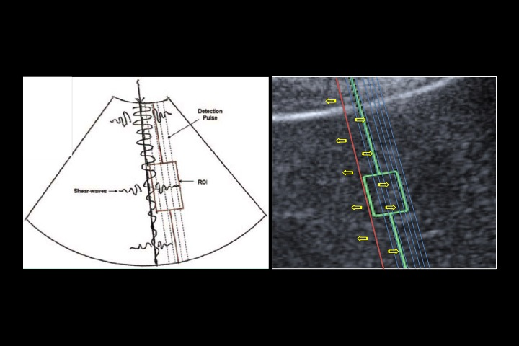
Acoustic Radiation Force Impulse – ARFI
Ultrasound
waves
Acoustic wave
ROI

Slide 14
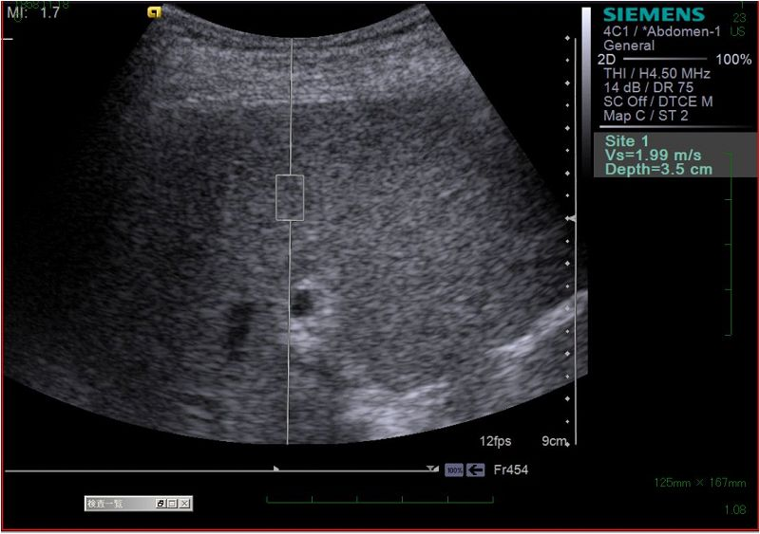
Acoustic Radiation Force Impulse – ARFI
There are not validation criteria for this method
Most specialists use those from Fibroscan

Slide 15
Acoustic Radiation Force Impulse – ARFI
N=112 VHC
AUROC: 0.94 F≥2
0.86 F≥3
0.91 F4
Cut-off: F2 1.34 m/s
F3 1.61 m/s
F4 2.00 m/s
Lupsor M, Badea R, Stefanescu H, Sparchez Z, Branda H, Serban A, Maniu A. Performance of a new elastographic method (ARFI technology) compared to unidimensional transient elastography in the noninvasive assessment of chronic hepatitis C. Preliminary results. J Gastrointestin Liver Dis. 2009 Sep;18(3):303-10. PubMed PMID: 19795024.

Slide 16

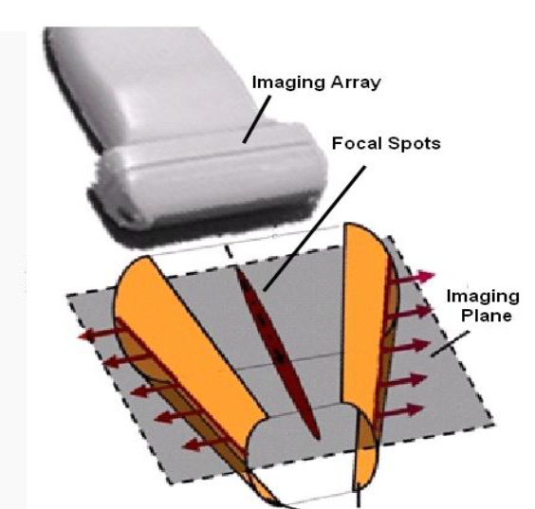
Shear-Wave Elastography (SWE)
Most recent of the techniques is the result of over 30 years of research.
Brings innovations in the domain of ultrasonography (SonicTouchTM si UltrafastTM Imaging)
Notes:
16
Focalizeaza ultrasunetele succesiv la adancimi diferite, rezultand o propagare a undelor de forfecare in forma de con (ST).
UFI – achizitie pana la 20000 img/sec.

Slide 17
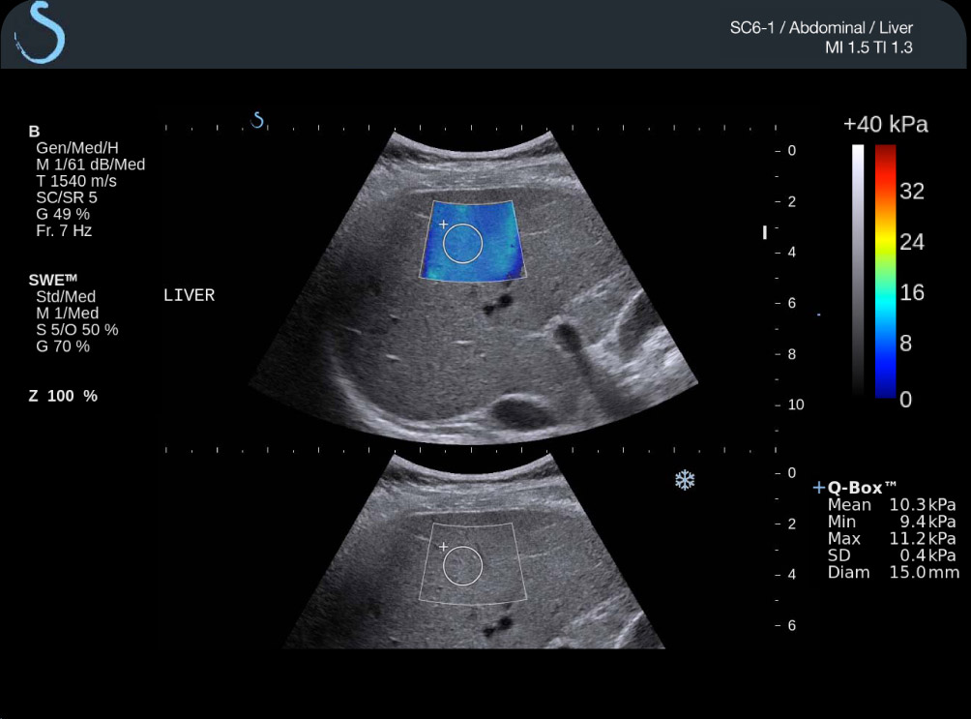
Shear-Wave Elastography (SWE)
Notes:
17
Focalizeaza ultrasunetele succesiv la adancimi diferite, rezultand o propagare a undelor de forfecare in forma de con (ST).
UFI – achizitie pana la 20000 img/sec.

Slide 18
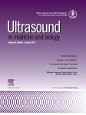
Shear-Wave Elastography (SWE)
N= 113 VHC
Comparatie cu FS
FS SWE
AUROC F≥2 0.846 0.948
F≥3 0.857 0.962
F4 0.940 0.968
Rezultatele indica o utilitate deosebita mai ales pentru identificarea stadiilor precirotice
Bavu E, Gennisson JL, Couade M, Bercoff J, Mallet V, Fink M, Badel A, Vallet-Pichard A, Nalpas B, Tanter M, Pol S. Noninvasive in vivo liver fibrosis evaluation using supersonic shear imaging: a clinical study on 113 hepatitis C virus patients. Ultrasound Med Biol. 2011 Sep;37(9):1361-73. doi: 10.1016/j.ultrasmedbio.2011.05.016. Epub 2011 Jul 20. PubMed PMID: 21775051.
Notes:
18
Focalizeaza ultrasunetele succesiv la adancimi diferite, rezultand o propagare a undelor de forfecare in forma de con (ST).
UFI – achizitie pana la 20000 img/sec.

Slide 19
Elastography indications for chronic hepatitis
Initial staging (indication for treatment or not)
Estimation of the complications (EV, HCC)
Monitoring of the fibrosis (natural history or treated patients)
Estimating the risk of developing complications

Slide 20
Elastography as a predictor for portal hypertension
PHT is appreciated by HVPG – an invasive maneuver
PHT is considered significant when HVPG is over 10 mmHg
HVPG over 12 mmHg indicates high risk for bleeding
HVPG should be indicated in all patients with cirrhosis to estimate the risk and for prognostic [1]
HVPG is usefull for monitoring too [1]
1. De Franchis R. Revising consensus in portal hypertension: report of the Baveno V consensus workshop on methodology of
diagnosis and therapy in portal hypertension. J Hepatol. 2010;53:762–768.

Slide 21
Elastography as a predictor for portal hypertension
Both liver stiffness (LS) and splenic stiffness are predictors of PHT [2,3]
LS is correlated with HVPG (r=0.81, p<0.001 for Fibroscan and r=0.611, p<0.001 for SWE) [3]
Splenic stiffness indicates Fibroscan as being superior to SWE (AUROC 0.87 vs 0.64, p=0.003) in determining significant PHT [3]
2. Vizzutti F, Arena U, Romanelli RG, Rega L, Foschi M, Colagrande S, Petrarca A, Moscarella S, Belli G, Zignego AL, et al. Liver stiffness
measurement predicts severe portal hypertension in patients with HCV-related cirrhosis. Hepatology. 2007;45:1290–1297.
3. Elkrief L, Rautou PE, Ronot M, Lambert S, Dioguardi Burgio M, Francoz C, Plessier A, Durand F, Valla D, Lebrec D, et al. Prospective comparison
of spleen and liver stiffness by using shear-wave and transient elastography for detection of portal hypertension in cirrhosis. Radiology.
2015;275:589–598.

Slide 22
Elastography as a predictor for portal hypertension
Fibroscan has a sensibility of 79% (CI95% = 0.58-0.91) and a specificity of 90% (CI95% = 0.81-0.91) in identifying significant PHT [4]
Zhang in 2015 indicatesthat for a value of 13.6KPa, Fibroscan has a sensibility of 72.5% and a specificity of 83.8% in detecting significant PHT[5]
4. Shi KQ, Fan YC, Pan ZZ, Lin XF, Liu WY, Chen YP, Zheng MH. Transient elastography: a meta-analysis of diagnostic accuracy in evaluation of portal hypertension in chronic liver disease. Liver Int. 2013;33:62–71.
5. Zhang W, Wang L, Wang L, Li G, Huang A, Yin P, Yang Z, Ling C, Wang L. Liver stiffness measurement, better than APRI, Fibroindex, Fib-4, and NBI gastroscopy, predicts portal hypertension in patients with cirrhosis. Cell Biochem Biophys. 2015;71:865–873.

Slide 23
Elastography as a predictor for portal hypertension
Another study that compares Fibroscan with ARFI showed that both correlate significantly with PHT (r=0.765 for Fibroscan si r=0.646 for ARFI, both with p<0.001).
For a cut-off of 2.58 m/s, ARFI has a sensibility of 71.4% and a specificity of 83.87% in identifying significant PHT [6]
The identification of significant PHT is a step towards identifying patients with EV at risk of bleeding .
6. Salzl P, Reiberger T, Ferlitsch M, Payer BA, Schwengerer B, Trauner M, Peck-Radosavljevic M, Ferlitsch A. Evaluation of portal hypertension and varices by acoustic radiation force impulse imaging of the liver compared to transient elastography and AST to platelet ratio index. Ultraschall Med. 2014;35:528–533
Notes:
23

Slide 24
Elastography as a predictor for the presence of EV and risk of bleeding
For a value of 17.6 Kpa, Fibroscan predicts with a sensibility of 90% and a specificty of 43% the presence of EV [7, 8] (AUROC = 0.76).
Studies have shown a good correlation between the value of Fibroscan and the degree of EV
7. Kazemi F, Kettaneh A, N’kontchou G, Pinto E, Ganne-Carrie N, Trinchet JC, Beaugrand M. Liver stiffness measurement selects patients with cirrhosis at risk of bearing large oesophageal varices. J Hepatol. 2006;45:230–235
8. Bureau C, Metivier S, Peron JM, Selves J, Robic MA, Gourraud PA, Rouquet O, Dupuis E, Alric L, Vinel JP. Transient elastography accurately predicts presence of significant portal hypertension in patients with chronic liver disease. Aliment Pharmacol Ther. 2008;27:1261–1268.

Slide 25
Elastography as a predictor for the presence of EV and risk of bleeding
Fibroscan can predict Paquet stage II EV – AUROC = 0.85 (CI95% = 0.75-0.94)[9]
For ARFI, the correlation is less good – AUROC = 0.58 (CI95% = 0.48 – 0.67) [10]
Liver elastography can be used in combination with spleen diameter and platelet number for the identification of patients with bleeding risk [11]
9. Pár G, Trosits A, Pakodi F, Szabó I, Czimmer J, Illés A, Gódi S, Bajor J, Sarlós P, Kenyeres P, et al. [Transient elastography as a predictor of oesophageal varices in patients with liver cirrhosis] Orv Hetil. 2014;155:270–276.
10. Vermehren J, Polta A, Zimmermann O, Herrmann E, Poynard T, Hofmann WP, Bojunga J, Sarrazin C, Zeuzem S, Friedrich-Rust M. Comparison of acoustic radiation force impulse imaging with transient elastography for the detection of complications in patients with cirrhosis. Liver Int. 2012;32:852–858.
11. Kim BK, Kim do Y, Han KH, Park JY, Kim JK, Paik YH, Lee KS, Chon CY, Ahn SH. Risk assessment of esophageal variceal bleeding in B-viral liver cirrhosis by a liver stiffness measurement-based model. Am J Gastroenterol. 2011;106:1654–1652, 1730

Slide 26
Elastography as a predictor for the presence of HCC
Liver stiffness is significantly increased in patients that develop HCC compared with general population and even to cirrhotic patients [12]
Grace Wong developed a score that include Fibroscan, age and seric albumin level and has an AUROC de 0.89 for identifying HCC patients with a very good negative prediction rate (99.4-100%).
12. Wong GL, Chan HL, Wong CK, Leung C, Chan CY, Ho PP, Chung VC, Chan ZC, Tse YK, Chim AM, et al. Liver stiffness-based optimization of hepatocellular carcinoma risk score in patients with chronic hepatitis B. J Hepatol. 2014;60:339–345

Slide 27
Elastography as a predictor for the presence of HCC
The study conducted by Diana Feier indicate a significantly increased liver stiffness in HCC patients (42 Kpa vs 27 Kpa) [13].
Jung showed that LS can be part of a predictive model that identifies patients with higher risk for HCC recurrence. It is correlated significantly with age, male sex, alcohol intake, hipoalbuminemia, Hbe antigen positivity and LS over 8 Kpa [14]
13. Feier D, Lupsor Platon M, Stefanescu H, Badea R. Transient elastography for the detection of hepatocellular carcinoma in viral C liver cirrhosis. Is there something else than increased liver stiffness? J Gastrointestin Liver Dis. 2013;22:283–289.
14. Jung KS, Kim JH, Kim SU, Song K, Kim BK, Park JY, Kim do Y, Ahn SH, Moon do C, Song IJ, et al. Liver stiffness value-based risk estimation of late recurrence after curative resection of hepatocellular carcinoma: development and validation of a predictive model. PLoS One. 2014;9:e99167.

Slide 28
Elastography as a predictor for the survival
Many studies showed that LS is inversely correlated with survival
G Wong showed that the increase of Fibroscan value between two visits indicate the occurrence of an hepatic event [15]
15. Wong GL, Chan HL, Yu Z, Wong CK, Leung C, Ho PP, Chan CY, Chung VC, Chan ZC, Tse YK, et al. Noninvasive assessments of liver fibrosis with transient elastography and Hui index predict survival in patients with chronic hepatitis B. J Gastroenterol Hepatol. 2015;30:582–590.

Slide 29
Elastography as a predictor for the survival
Pang showed that Fibroscan result is a predictor for the occurrence of the complications (risk increases with 1.05 per Kpa), with the incidence of the complications over 2 years of 2.6%, 9%, 19% si 34% for values of <10KPa, 10-19.9 Kpa, 20-39.9 KPa and over 40KPa. [16]
Verignol’s study showed that elastography can predict 5 years survival rate in patients with HCV infection [17]
16. Pang JX, Zimmer S, Niu S, Crotty P, Tracey J, Pradhan F, Shaheen AA, Coffin CS, Heitman SJ, Kaplan GG, et al. Liver stiffness by transient elastography predicts liver-related complications and mortality in patients with chronic liver disease. PLoS One. 2014;9:e95776.
17. Vergniol J, Foucher J, Terrebonne E, Bernard PH, le Bail B, Merrouche W, Couzigou P, de Ledinghen V. Noninvasive tests for fibrosis and liver stiffness predict 5-year outcomes of patients with chronic hepatitis C. Gastroenterology. 2011;140:1970–1979, 1979.e1-3.

Slide 30
16. Pang JX, Zimmer S, Niu S, Crotty P, Tracey J, Pradhan F, Shaheen AA, Coffin CS, Heitman SJ, Kaplan GG, et al. Liver stiffness by transient elastography predicts liver-related complications and mortality in patients with chronic liver disease. PLoS One. 2014;9:e95776.

Slide 31
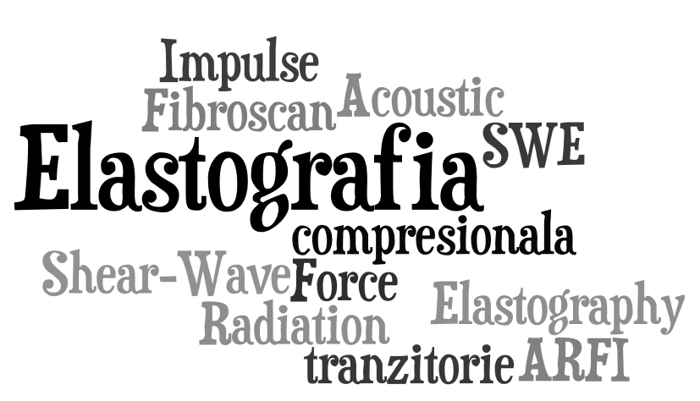
VA MULTUMESC!

